Slide 1
Made By JOYITA HAZRA
VALUE BASED PRICING MEETS DATA SCIENCE
A CONCEPT FOR SPARE PART VALUATION

Slide 2
ABSTRACT
Turning data into value is an exciting challenge for Data Science in times of an exponential growing amount of data. Maintenance, Repair and Overhaul companies are facing pricing related decision problems on a daily basis. The industry sits on vast amount of data. Due to lacks of transparency in the surplus part market and missing concepts to efficiently use internal data, existing information is not used exhaustively to improve data-based part utilization decisions. An early-stage concept for automated spare part valuation which classifies pricing data before applying appropriate valuation methods is presented and hereby combines methods from multiple disciplines. Information from heterogeneous sources is aggregated, transformed and then supports machine learning methods to automatically determine a Fair Market Value for surplus spare parts. Handling incomplete historical data sets as well as validating the calculated Fair Market Value are some of the challenges which become visible.

Slide 3
INTRODUCTION
‘We are drowning in information but starved for knowledge.’
Until today, decision makers still complain in a very similar way about ‘drowning in data while thirsting for information’ . In aircraft industry, aircraft maintenance has to face high safety regulations but also operate in a very short timeframe to avoid very expensive aircraft downtime. Maintenance Repair and Overhaul (MRO) companies, are constantly confronted with managing the logistics of spare parts.
There are several ways to determine a price as foundation for the part utilization decision, including auction based market places and prediction models based on historical data. As soon as context based value information is needed for internal decision making, external determined prices fail to include company-specific information and don’t provide a sufficient basis for decision-making. Predicting a value based on historical data however may work well for market players with a huge amount of structured and high quality historical data. In this paper, we propose a concept for combining methods from multiple disciplines with the goal of automated part valuation.

Slide 4
PRICING
’Price in business market is what a customer firm pays a supplier for its product offering’. ’Value in business markets is the worth in monetary terms of the technical, economical service and social benefits a customer company receives in exchange for the price it pays for a market offering’.
Cost Based Pricing uses data from cost accounting and for example considers original purchase price and internal costs (e.g. repairing) to determine a selling price. It doesn't take the competition or market into account and is therefore considered as the weakest approach.
Competition Based Pricing observes price levels of the competition and uses market prices for orientation in price setting but dismisses company-internal information such as inventory or repair costs of defective spare parts.
Value Based Pricing uses a predefined value as the basis for determining the price. As only value based pricing takes company internal information into account, this approach is now described in more detail to discuss its potential to serve as a foundation for decision making and price setting.

Slide 5
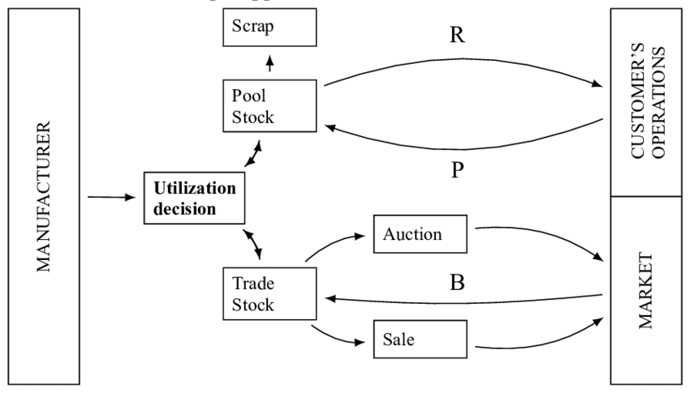
Understanding the Spare Part Supply Chain
Alternative Closed Loop Supply Chain Process from a MRO point of view

Slide 6
Framework for Automated Spare Part Valuation
Design a framework in order to automatically determine a FMV (Fair Market Value) for surplus spare parts and present it to the end user in a meaningful way (ASPV framework in following).
Find a way to prepare data as foundation for automated valuation of surplus spare parts.
Validate the calculated FMV.

Slide 7
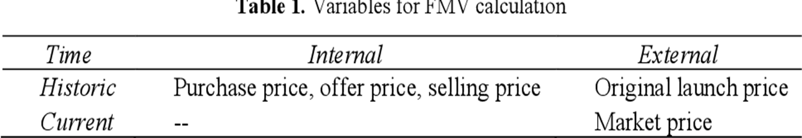

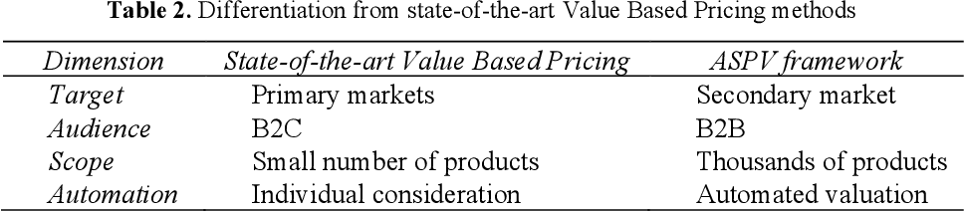

Slide 8
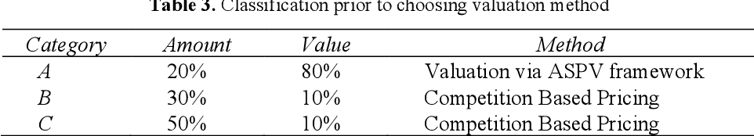
Classification of Pricing Information
Based on the Pareto principle
• Classification – Find attributes for sorting products into A, B and C groups,
• Differentiation – set differentiation policy for each class,
• Allocation – allocate (pricing) effort according to classification and differentiation.

Slide 9
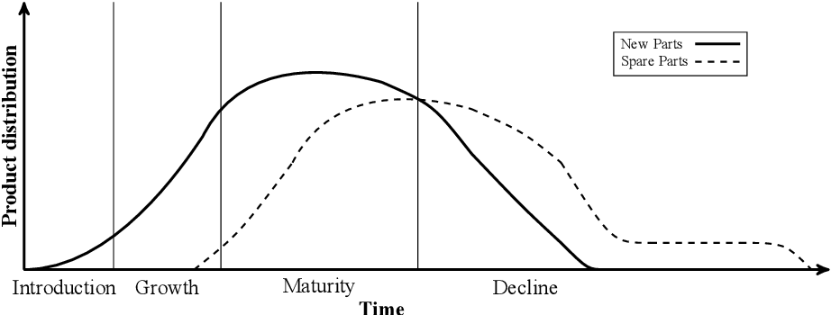
The number of new products and the demand for remanufactured products or spare parts is positively correlated but also delayed in time. As spare parts are removed some time later from operations, the number of parts on the surplus market peaks after the maturity phase of new parts

Slide 10
In the context of this scenario, the following procedure is therefore recommended:
• Classification – Find attributes for sorting products into A, B and C groups,
• Differentiation – set differentiation policy for each class,
• Refine – differentiate further by putting in perspective of product lifecycle,
• Apply – use ASPV framework for A parts and competition based pricing for B and C products,
• Revise – repeat process regularly based on improved data

Slide 11
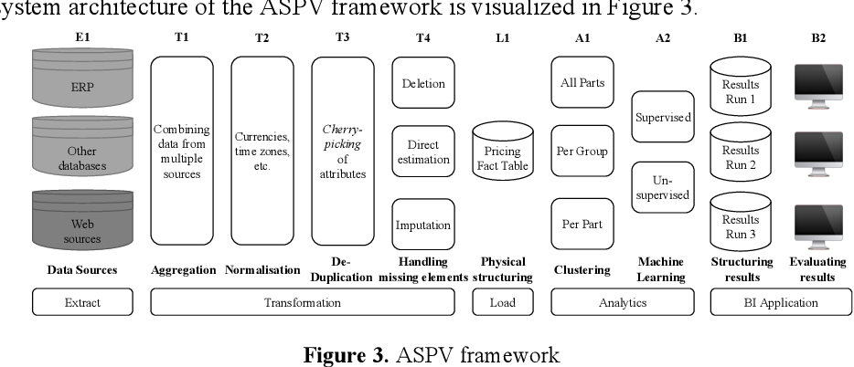
ASPV Framework

Slide 12
The first step is the extraction of raw data from available data sources which include internal ERP systems, other internal databases and web sources from trading platforms (E1). Every data source contains complementary pricing information, that is why data pre-processing is of high importance prior to applying machine learning methods. Extracted data is now aggregated (T1) and subsequently normalized concerning currencies, time zones etc. (T2). The resulting datasets containing pricing information are now uniquely distinguishable by the combination of part number and date. There are usually multiple pricing points per part, duplicative datasets are combined (T3). Multiple incomplete datasets are combined to one complete dataset. In case of multiple available data, aggregation or selection methods need to be selected according to the business process environment. Still missing elements need to be handled (T4). Two simple and widely used concepts are list wise and pairwise deletion. In case of list wise deletion a complete record is deleted when at least one attribute is missing.

Slide 13
This might be the quickest and most effortless approach but also loses much data. Pairwise deletion on the other hand doesn’t always ignore incomplete datasets but considers records with connected attributes. Consider the following example: the correlation between attribute A and attribute B is calculated. Pairwise deletion takes all records (including incomplete) into account where attribute A and B still exist. The result of the preceding transformation is a clean pricing fact table (L1) which is the basis for applying analytics methods. Now parts are combined in clusters of different size (A1). Clustering depends on the underlying characteristics of the parts, e.g. number and size of part groups. Machine Learning methods can then be applied on different aggregation levels (A2). Resulting is a FMV per part number and part date (B1). Finding a suitable machine learning method depends on the underlying data structure. The framework’s performance can be evaluated by repeatedly running the process in multiple combinations from E1 to A2 and comparing the results (B1) in B2.

Slide 14
The Challenge of Validation
two-step process for using the ASPV to find a FMV: First, automate the valuation process, second increase objectivity of the automated valuation to improve the status quo.
Supervised machine learning methods could be used to automate the valuation process.
The decision could be done by comparing time periods before using the FMV and periods while using the FMV for decision making.
The challenges coming with this approach are:
1. Separating the FMV from its exogenous influence factors such as
(a) macroeconomic factors like overall economic growth,
(b) general profitability within the industry sector,
(c) general market conditions,
2. and then again, handling emerging missing values which might prevent this separation.

Slide 15
CONCLUSION
To find methods to determine a surplus spare part’s value, existing pricing literature was analyzed. As Cost Based and Competitive Based Pricing are not applicable, Value Based Pricing is the right approach to find a Fair Market Value. The concept of the ASPV framework is an expansion of Value Based Pricing for manual value determination in primary markets to automated valuation in secondary markets.

Slide 16
THANK YOU

